Slide 1
Digital Logic & Design
Chapter 1,2, 3 Extra Slides
Copyrights: Dr Syed Zulqadar Hassan

Slide 2
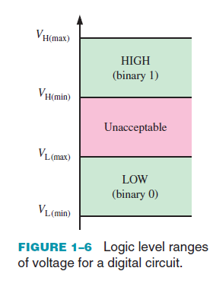
Binary Digits
Notes:
Demorgan’s Theorems can be applied to expressions having any number of variables
Demorgan’s Theorem can be applied to a combination of other variables

Slide 3
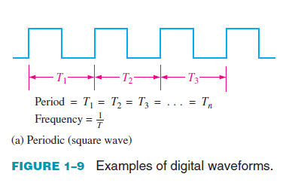
Waveform Characteristics
Notes:
Demorgan’s Theorems can be applied to expressions having any number of variables
Demorgan’s Theorem can be applied to a combination of other variables

Slide 4
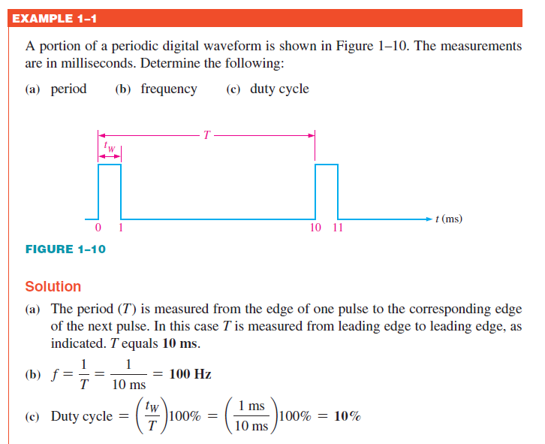
Waveform Characteristics
Notes:
Demorgan’s Theorems can be applied to expressions having any number of variables
Demorgan’s Theorem can be applied to a combination of other variables

Slide 5
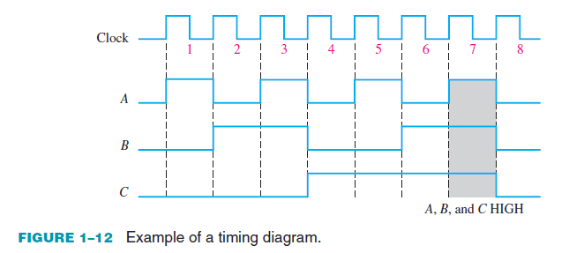
Timing Diagrams
Notes:
Demorgan’s Theorems can be applied to expressions having any number of variables
Demorgan’s Theorem can be applied to a combination of other variables

Slide 6
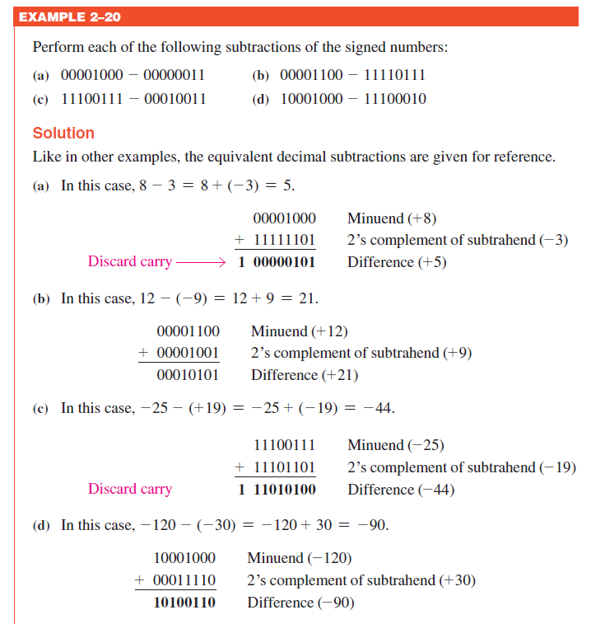
Arithmetic Operations with Signed Numbers
Notes:
Demorgan’s Theorems can be applied to expressions having any number of variables
Demorgan’s Theorem can be applied to a combination of other variables

Slide 7
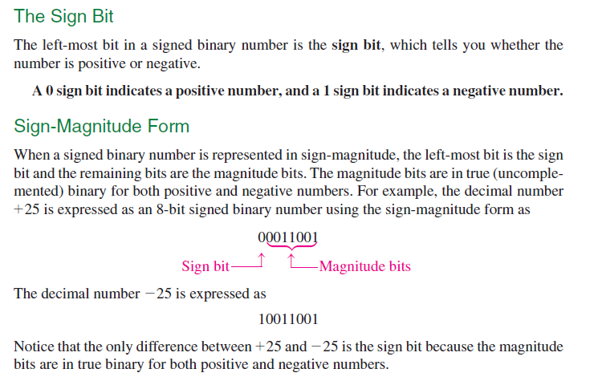
Signed Numbers
Notes:
Demorgan’s Theorems can be applied to expressions having any number of variables
Demorgan’s Theorem can be applied to a combination of other variables

Slide 8
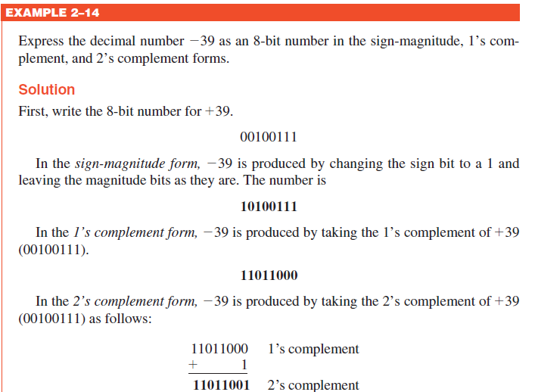
Signed Numbers
Notes:
Demorgan’s Theorems can be applied to expressions having any number of variables
Demorgan’s Theorem can be applied to a combination of other variables

Slide 9
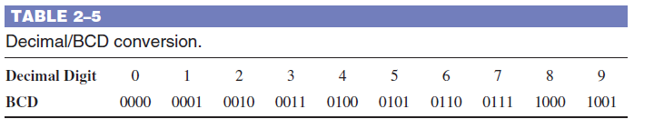
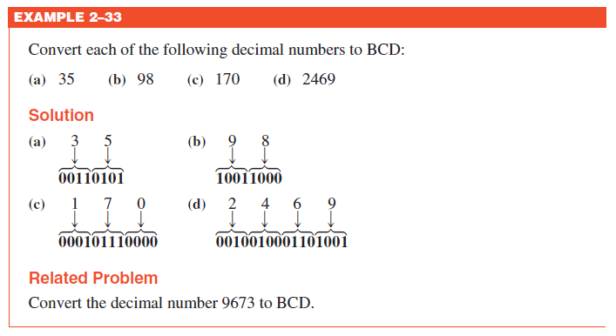
Binary Coded Decimal (BCD)
Notes:
Demorgan’s Theorems can be applied to expressions having any number of variables
Demorgan’s Theorem can be applied to a combination of other variables

Slide 10
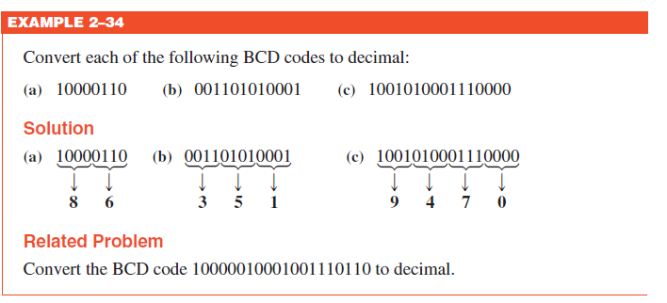
Binary Coded Decimal (BCD)
Notes:
Demorgan’s Theorems can be applied to expressions having any number of variables
Demorgan’s Theorem can be applied to a combination of other variables

Slide 11
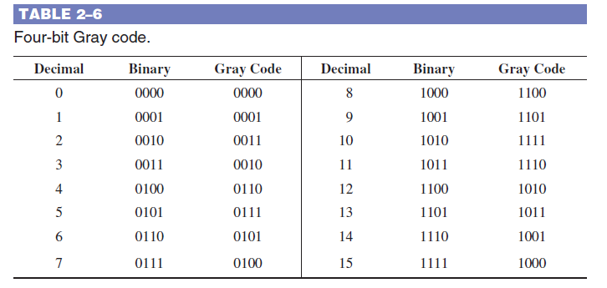
The Gray Code
Notes:
Demorgan’s Theorems can be applied to expressions having any number of variables
Demorgan’s Theorem can be applied to a combination of other variables

Slide 12
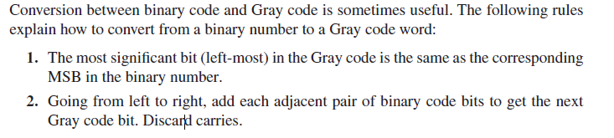
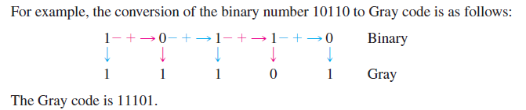
Binary-to-Gray Code Conversion
Notes:
Demorgan’s Theorems can be applied to expressions having any number of variables
Demorgan’s Theorem can be applied to a combination of other variables

Slide 13
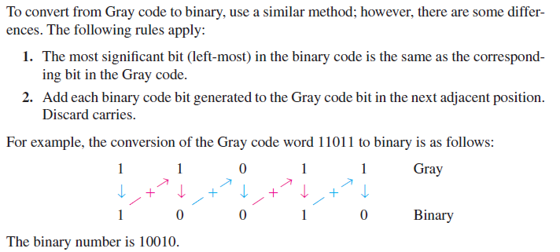
Gray-to-Binary Code Conversion
Notes:
Demorgan’s Theorems can be applied to expressions having any number of variables
Demorgan’s Theorem can be applied to a combination of other variables

Slide 14
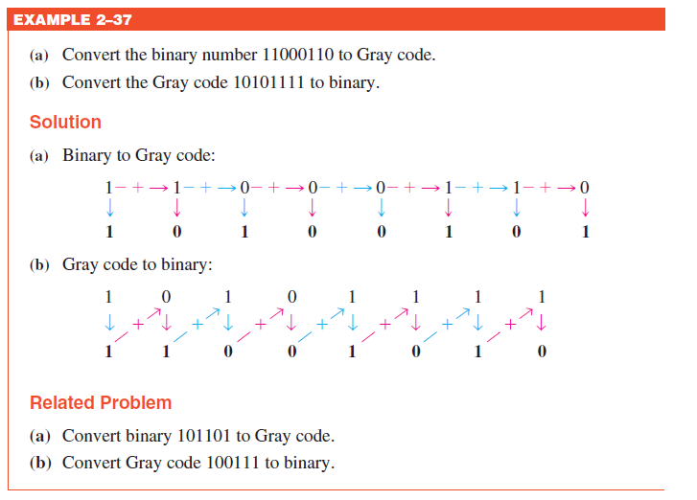
Gray-to-Binary Code Conversion
Notes:
Demorgan’s Theorems can be applied to expressions having any number of variables
Demorgan’s Theorem can be applied to a combination of other variables

Slide 15
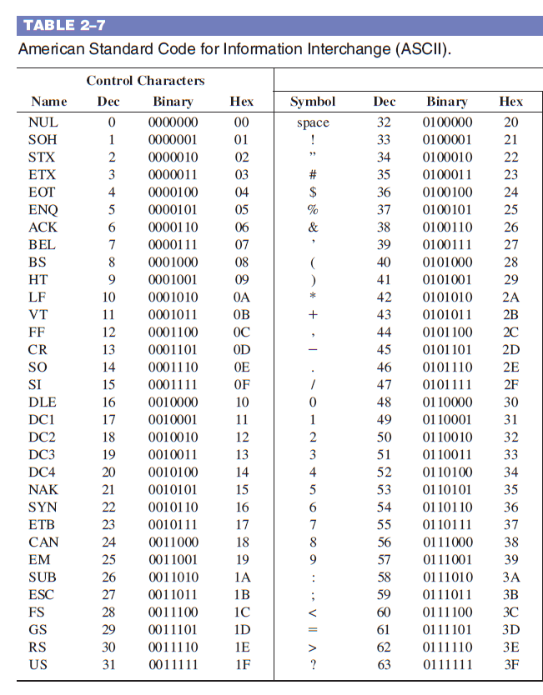
ASCII (American Standard Code for Information Interchange)
Notes:
Demorgan’s Theorems can be applied to expressions having any number of variables
Demorgan’s Theorem can be applied to a combination of other variables

Slide 16
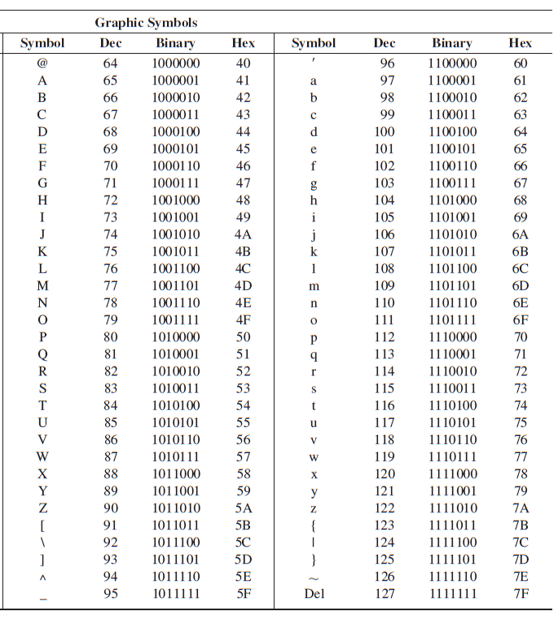
ASCII (American Standard Code for Information Interchange)
Notes:
Demorgan’s Theorems can be applied to expressions having any number of variables
Demorgan’s Theorem can be applied to a combination of other variables

Slide 17
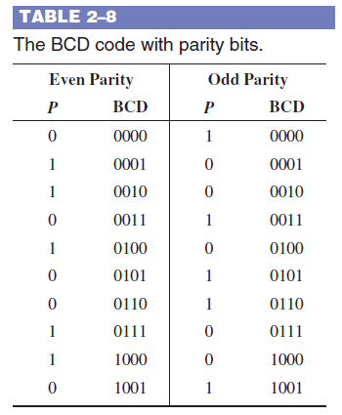
Parity Method for Error Detection
Notes:
Demorgan’s Theorems can be applied to expressions having any number of variables
Demorgan’s Theorem can be applied to a combination of other variables

Slide 18
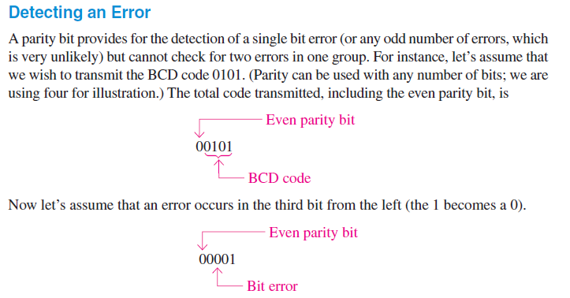
Parity Method for Error Detection
Notes:
Demorgan’s Theorems can be applied to expressions having any number of variables
Demorgan’s Theorem can be applied to a combination of other variables

Slide 19
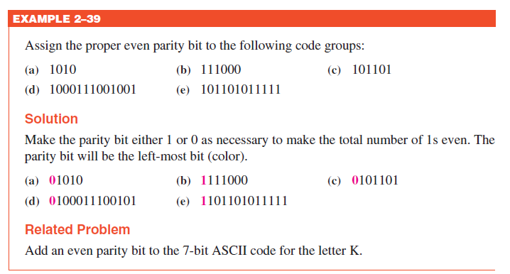
Parity Method for Error Detection
Notes:
Demorgan’s Theorems can be applied to expressions having any number of variables
Demorgan’s Theorem can be applied to a combination of other variables

Slide 20
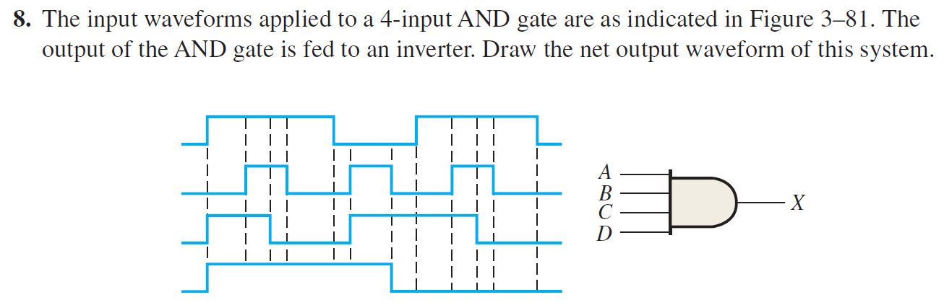
Problems
Notes:
Demorgan’s Theorems can be applied to expressions having any number of variables
Demorgan’s Theorem can be applied to a combination of other variables

Slide 21
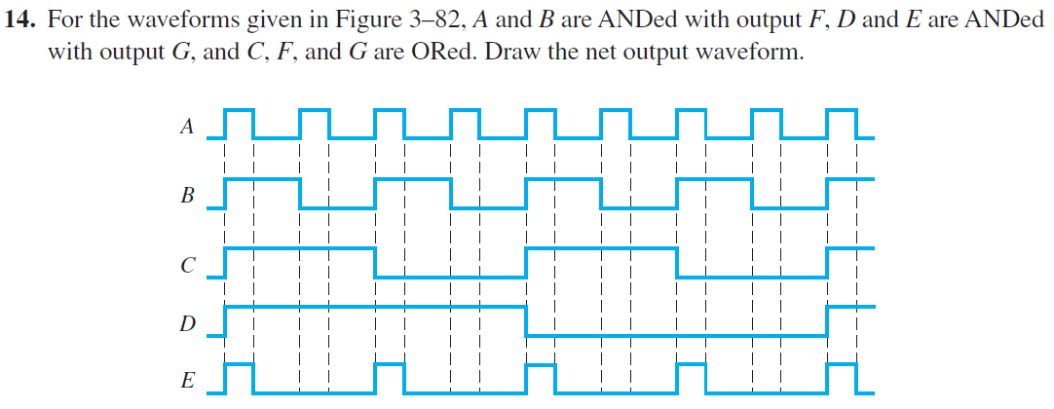
Problems
Notes:
Demorgan’s Theorems can be applied to expressions having any number of variables
Demorgan’s Theorem can be applied to a combination of other variables

Slide 22
Thank You

